Slide 1
Supplemental Western Blots: HMGA1 in Colon Tumors
Supplemental figures show repeat western blots of HMGA1 in colon tumors and adjacent non-malignant tissue, including uncropped images of the entire blots. The western blots show low or undetectable HMGA1 in non-malignant adjacent colon epithelium (labeled N or Normal) and high levels in invasive tumors from 6 different patient samples (labeled T for tumor in addition to Adenoma or Adenocarcinoma according to the histopathologic diagnosis. [The original blots and methods were published in PLoS One.2012;7(1):e30034; doi.org/10.1371/journal.pone.0030034. PMID: 22276142; repeat blots were performed from 6 additional patient tumor and matched, non-malignant adjacent samples]. Equal amounts of protein were loaded per lane and GAPDH is shown as a loading control.

Slide 2
1-29 – Gel Images Cropped for Figure
Adenoma
Adenocarcinoma
Adenocarcinoma
Normal
KDa
Normal
Normal
KDa
37
GAPDH
37
GAPDH
HMGA1
HMGA1
15
15
Case 1 Case 2 Case 3
Invasion
No Moderate Deep
(Submucosal) (Muscularis)
Metastatic
No No Yes
KDa
Adenoma
Adenocarcinoma
Adenocarcinoma
37
Normal
Normal
Normal
GAPDH
KDa
37
GAPDH
15
HMGA1
15
HMGA1
Case 4 Case 5 Case 6
Invasion
No Moderate Deep
(Submucosal) (Muscularis)
Metastatic
No No Yes

Slide 3
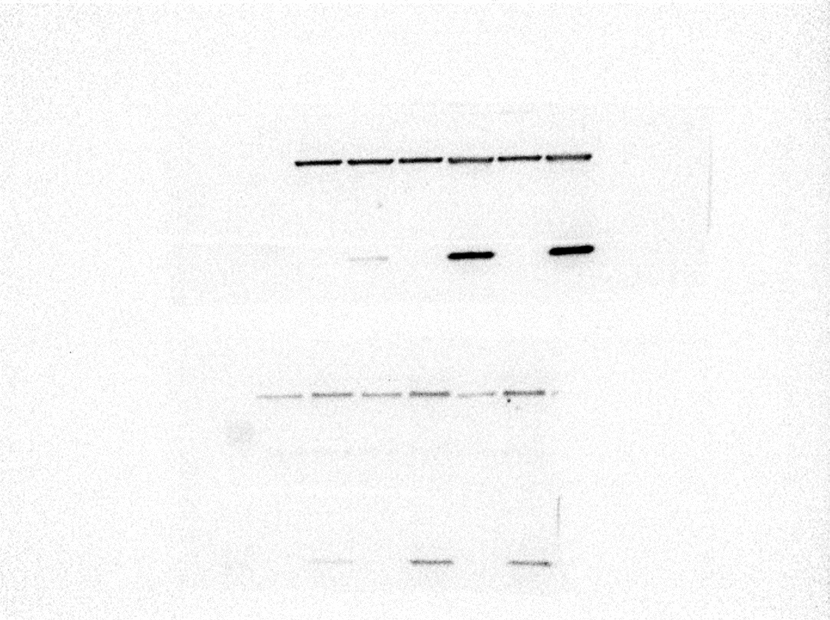

2-13 – Gel Images Cropped for Figure
Adenoma
Adenocarcinoma
Adenocarcinoma
KDa
Normal
Normal
Normal
KDa
37
GAPDH
37
GAPDH
GAPDH
HMGA1
HMGA1
15
HMGA1
15
Case 1 Case 2 Case 3
Gel-2
Invasion
No Moderate Deep
(Submucosal) (Muscularis)
KDa
Metastatic
No No Yes
Adenoma
Adenocarcinoma
Adenocarcinoma
37
GAPDH
Normal
Normal
Normal
GAPDH
KDa
37
GAPDH
HMGA1
15
HMGA1
15
HMGA1
Case 4 Case 5 Case 6
Gel-1
Invasion
No Moderate Deep
(Submucosal) (Muscularis)
Metastatic
No No Yes

Slide 4
1-29 – Full Gel Images
Gel 2: ________ ________ _________ ___________
Adenoma T1N0 T2N+ Liver Liver tumor
N/T N T N T N T Negative
Case # 3427 3681 3468 Control
KDa
37
GAPDH
Gel-2
15
HMGA1
37
GAPDH
Gel-1
15
HMGA1
Gel 1: ________ ________ _________ ___________
Adenoma T1N0 T2N+ Liver Liver tumor
N/T N T N T N T Negative
Case # 3451 3751 3687 Control
The blue arrows indicate where each gel was cut after which the upper half was probed for GAPDH while the bottom half was probed for HMGA1.

Slide 5
2-13 – Full Gel Images
Gel-2
KDa
37
GAPDH
Gel-2
15
HMGA1
37
GAPDH
Gel-1
15
HMGA1
The blue arrows indicate where each gel was cut after which the upper half was probed for GAPDH while the bottom half was probed for HMGA1.
Gel-1

